Slide 1
Information Retrieval with Long Legal Documents
By Michel Custeau
Supervised by Diana Inkpen

Slide 2
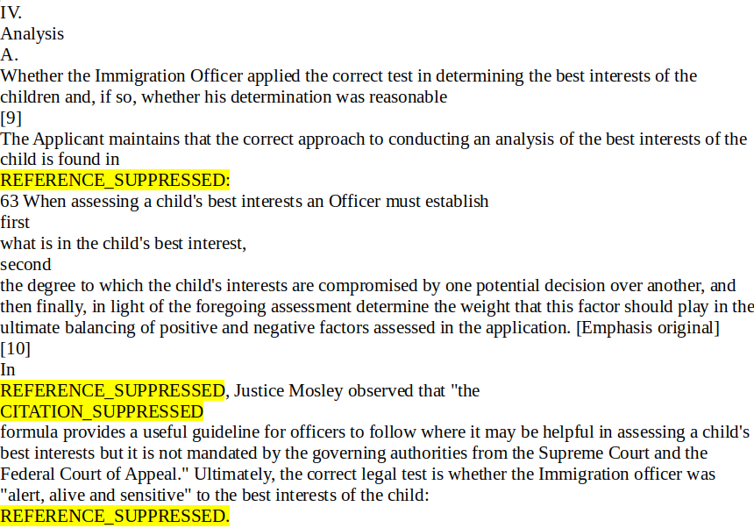
What is Information Retrieval?

Slide 3

How do you measure relevance?

Slide 4


How do you measure relevance?

Slide 5
Datasets
dataset | COLIEE-2021 train set | COLIEE-2021 test set | FIRE-2017-IRLeD
Number of query cases | 650 | 250 | 200
Number of documents | 2655 | 900 | 2000

Slide 6
Strategy 1: look at entire document

Slide 7
Results at top 10 documents
 | Canadian Legal Documents | Indian Legal Documents
Recall | 0.3889 | 0.3290
Precision | 0.1400 | 0.1645
F1 | 0.2059 | 0.2193

Slide 8
Strategy 2: Target word around the spots where a reference was removed

Slide 9
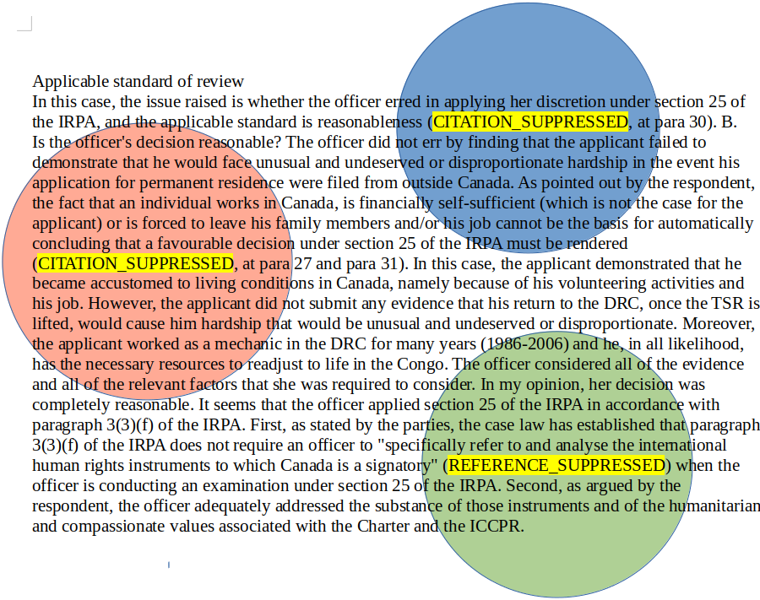

Slide 10
q = [ q₁ , q₂ , q₃ ]

Slide 11
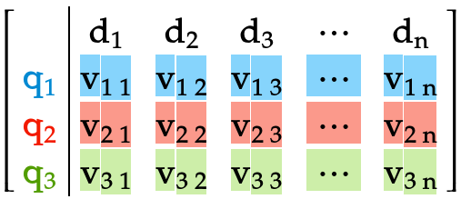
q = [ q₁ , q₂ , q₃ ]
Score( q , documents ) =

Slide 12

Ranked_docs = [doc 1 , doc 2, … , doc n]

Slide 13
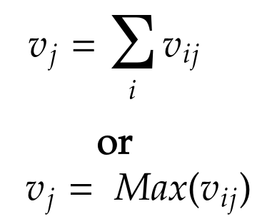
Ranked_docs = [doc 1 , doc 2, … , doc n]

Slide 14
Results
Canadian legal documents | Indian Legal Documents
 | Sum | Max | Sum | Max
Map score | 0.2746 | 0.2722 | 0.3215 | 0.4027
Precision at top 10 documents | 0.1489 | 0.1475 | 0.2050 | 0.2395
time | 975.4314024448395 | 1009.0124044418335 | 174.4975619316101 | 174.4893810749054
Number of words per fragment: 128

Slide 15
 | Canadian Legal Documents | Indian Legal Documents
Map score | 0.2453 | 0.2615
Precision at top 10 documents | 0.1377 | 0.1650
time | 856.4165976047516 | 330.2172038555145
Canadian legal documents | Indian Legal Documents
 | Sum | Max | Sum | Max
Map score | 0.2746 | 0.2722 | 0.3215 | 0.4027
Precision at top 10 documents | 0.1489 | 0.1475 | 0.2050 | 0.2395
time | 975.4314024448395 | 1009.0124044418335 | 174.4975619316101 | 174.4893810749054
Number of words per fragment: 128

Slide 16
Strategy 3: take advantage of document structure

Slide 17
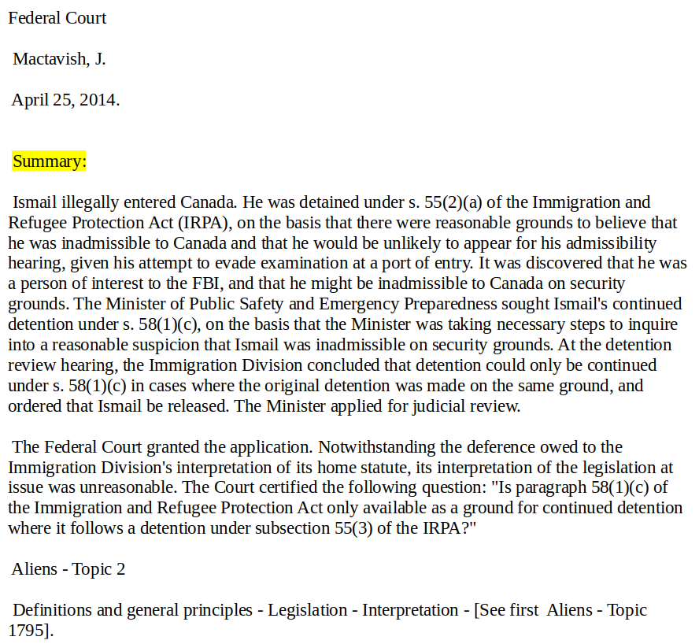
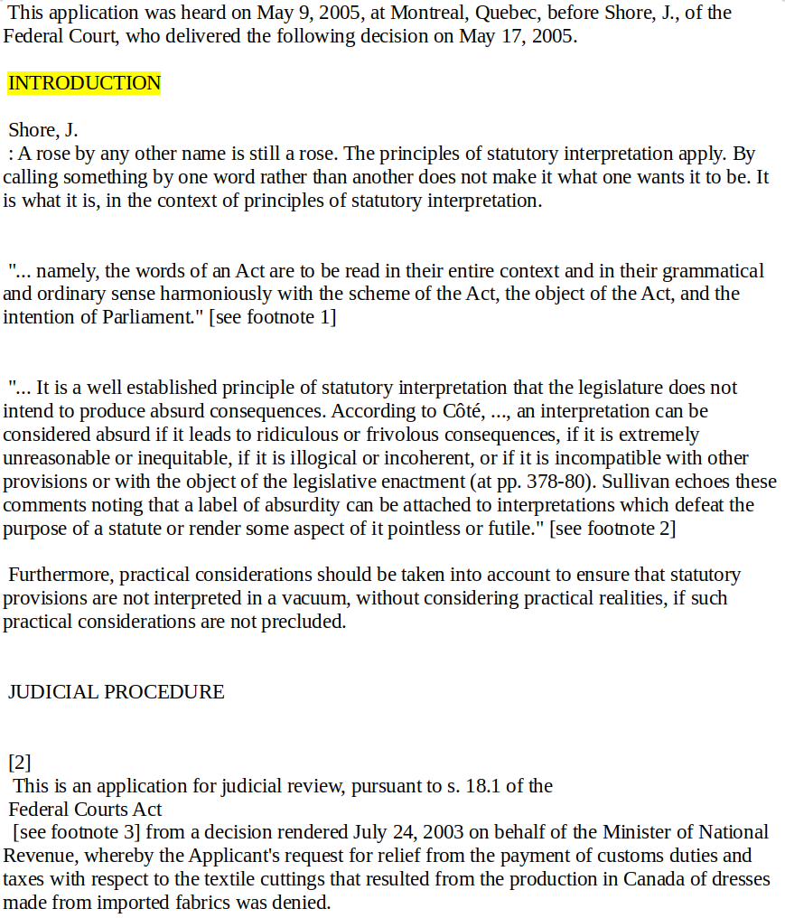

Slide 18
Results for Canadian legal documents
Map score | 0.2576
Precision at top 10 documents | 0.1406
time | 160.36449432373047
Number of words for each query and doc: 512

Slide 19
Comparison to initial results
 | Canadian Legal Documents
Map score | 0.2453
Precision at top 10 documents | 0.1377
time | 856.4165976047516
Map score | 0.2576
Precision at top 10 documents | 0.1406
time | 160.36449432373047
Number of words for each query and doc: 512

Slide 20
Main Takeaway: less is more

Slide 21
Questions?

